Slide 1


Gene-by-gene diversity exploration in large genome data sets
Sofia Hauck
D Phil (PhD) student

Slide 2
NGS: what is it good for?
High-throughput WGS is already here
Proven use in surveillance
Extending the benefit of existing data
Focus on genes, not isolates
DNA mutates randomly
So parts of the genomes with too much or too little diversity are being kept that way by evolution
With “big data”, signals stand out from the noise

Slide 3
Questions and goals
How can we use existing data to learn about the biology of pathogens?
Methods should be…
Simple and open (ideally free)
Make biological sense
Few assumptions
Robust to troublesome data

Slide 4
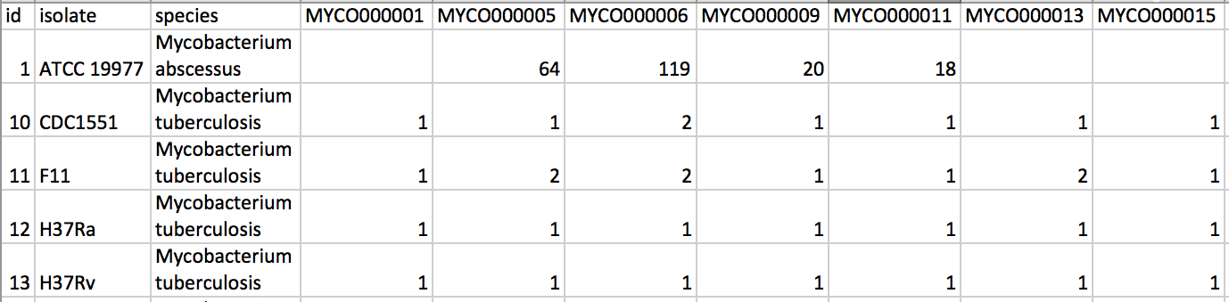
Starting point
Table of isolates and genes, with allele IDs
Plus any categories for loci, if known
Access to the FASTA files, either…
A folder with the files in your computer
Or the name of an open BIGSdb database

Slide 5


First phase: processing
Using Perl & MAFFT
Both free to install and use
Script with options
Can consider all alleles or remove singletons
Uses default MAFFT parameters or ones given
Creates aligned ClustalW and translated FASTA
Outputs a table with summary of results

Slide 6

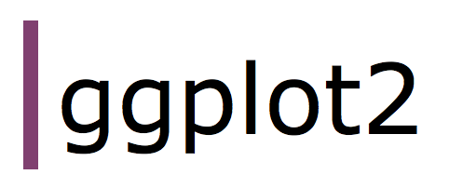

Second phase: visualisation
R with packages ggplot2 and Shiny
Again all free to install and use
But there is no need to install!
Try the app at our website:
https://apps-maidenlab.zoo.ox.ac.uk/GbGDiv/

Slide 7
Measuring diversity
count of unique nucleotide sequences
average length of those sequences
Calculated per locus
Count of all unique alleles in nucleotide format
Length is average of all alleles found
Analogous to substitutions per site
Called “AllelicDiv” in GbGDiv

Slide 8
Measuring selection
count of unique amino acid sequences
count of unique nucleotide sequences
Calculated per locus
Since have sequences, can translate
Then just check for duplicate amino acid sequences
Analogous to dN/dS ratio
Called “RatioCount” in GbGDiv

Slide 9
How robust is it?
No assumption about recombination
The unit is the coding sequence
Caveat: be careful with interpreting the results
Missing data doesn’t detract from results
Can add even pretty poorly assembled genomes
Caveat: if gaps are not random, might skew results
Have the option to ignore singletons (etc.)
Removes sequencing errors, lab-grown mutations
Caveat: removes most of the data

Slide 10
Closing thoughts
If you already have allele-based data analysis, explore it from the perspective of the genes
Get a grasp on the diversity and selection forces across your loci; plus paralogous, missing, etc.
Will be publishing soon, please try it out and send feedback so it can be improved!

Slide 11
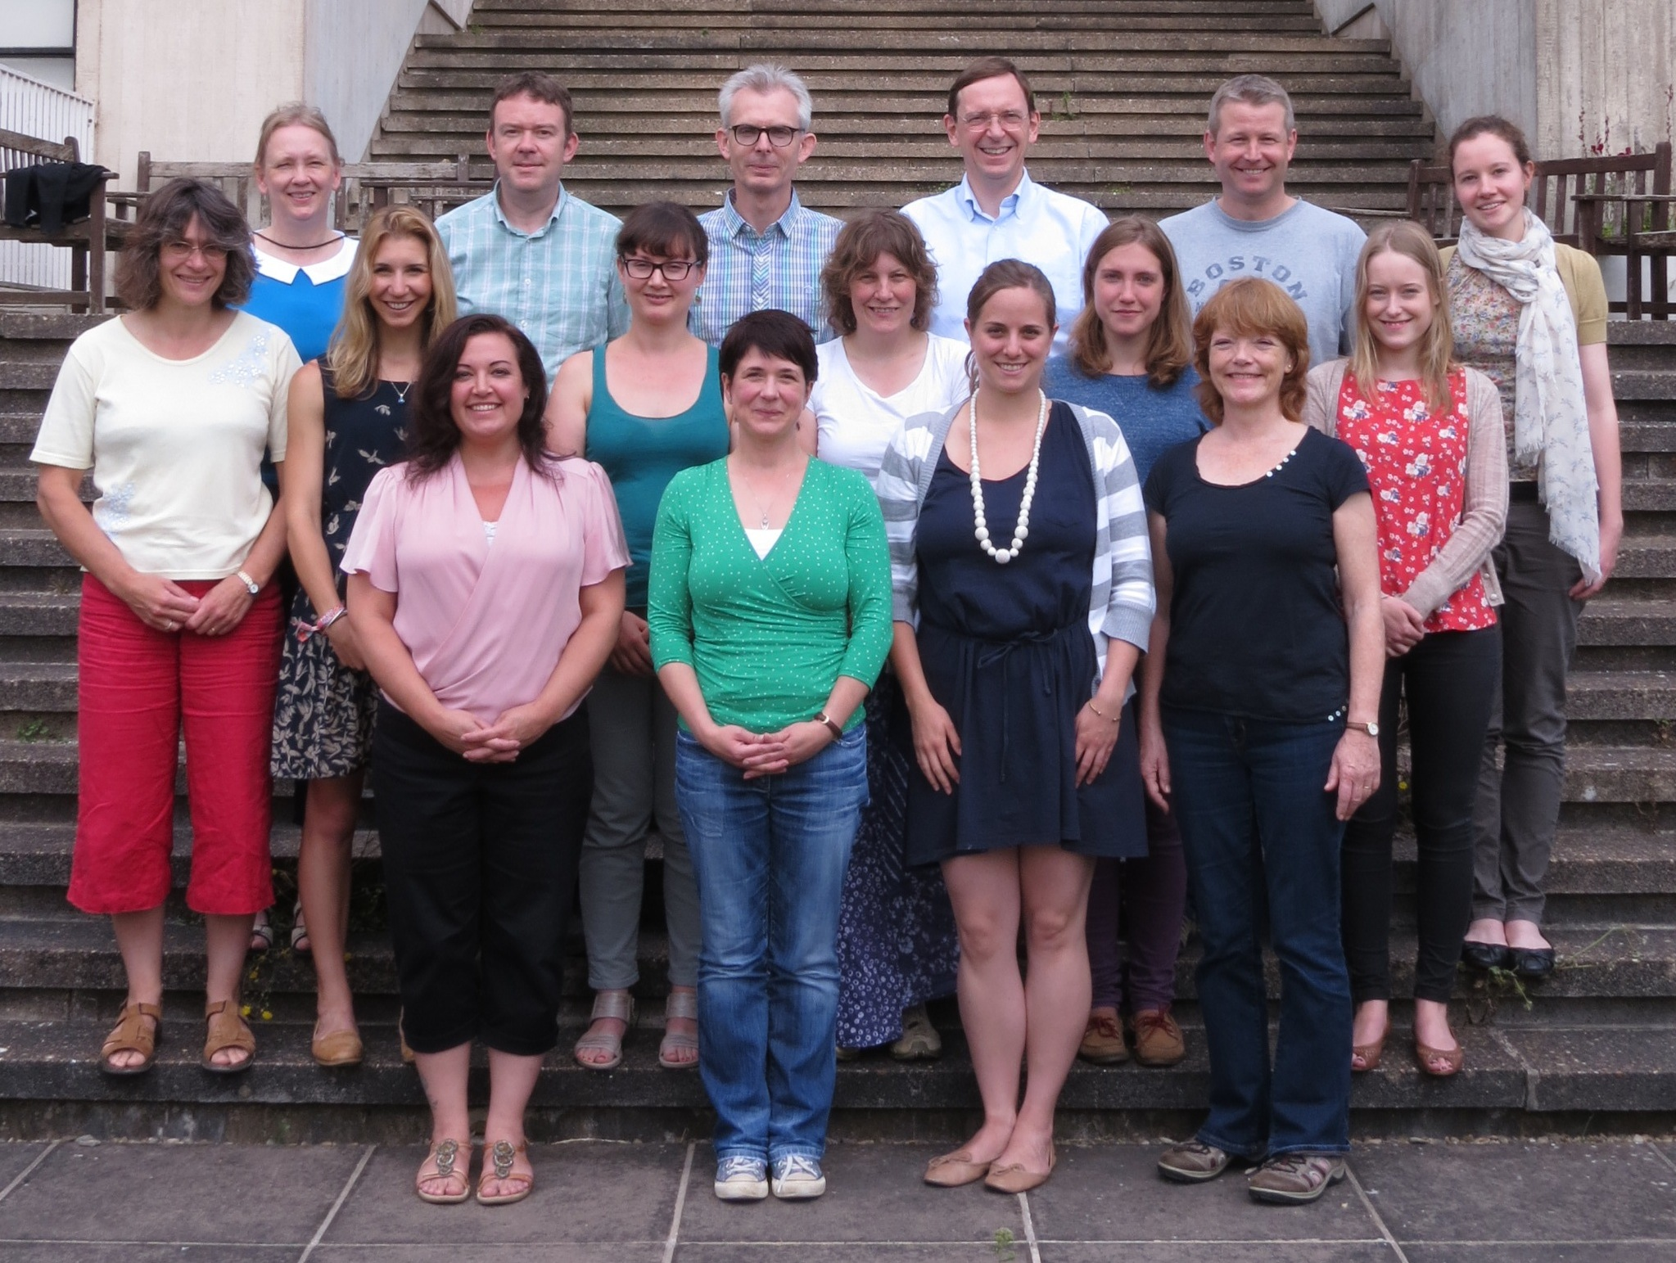


Acknowledgements
Supervisor: Martin Maiden
James Bray
Keith Jolley
Funding
http://maidenlab.zoo.ox.ac.uk/

Slide 12
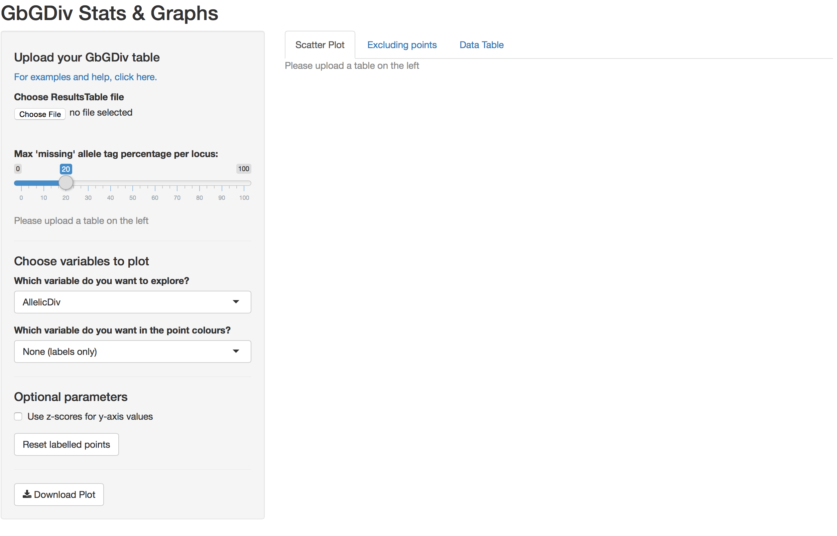

Slide 13
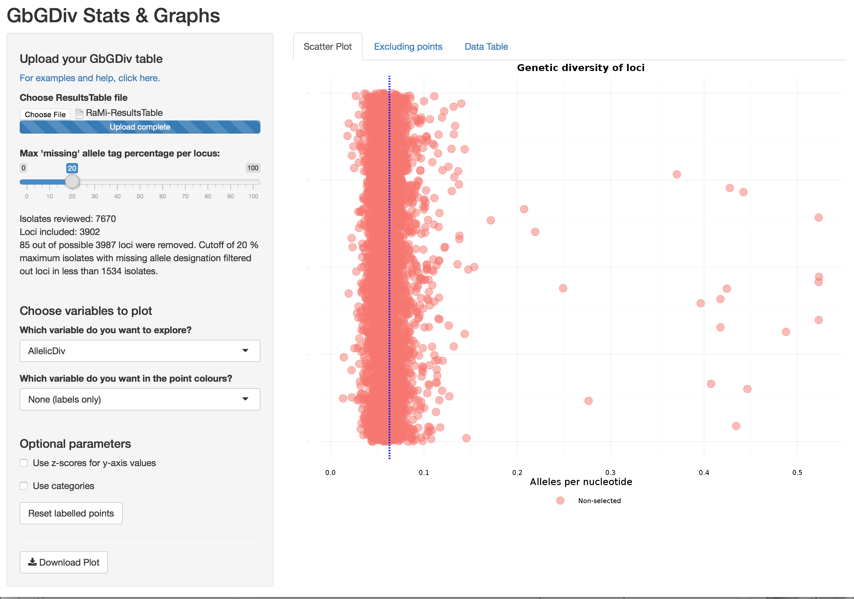

Slide 14
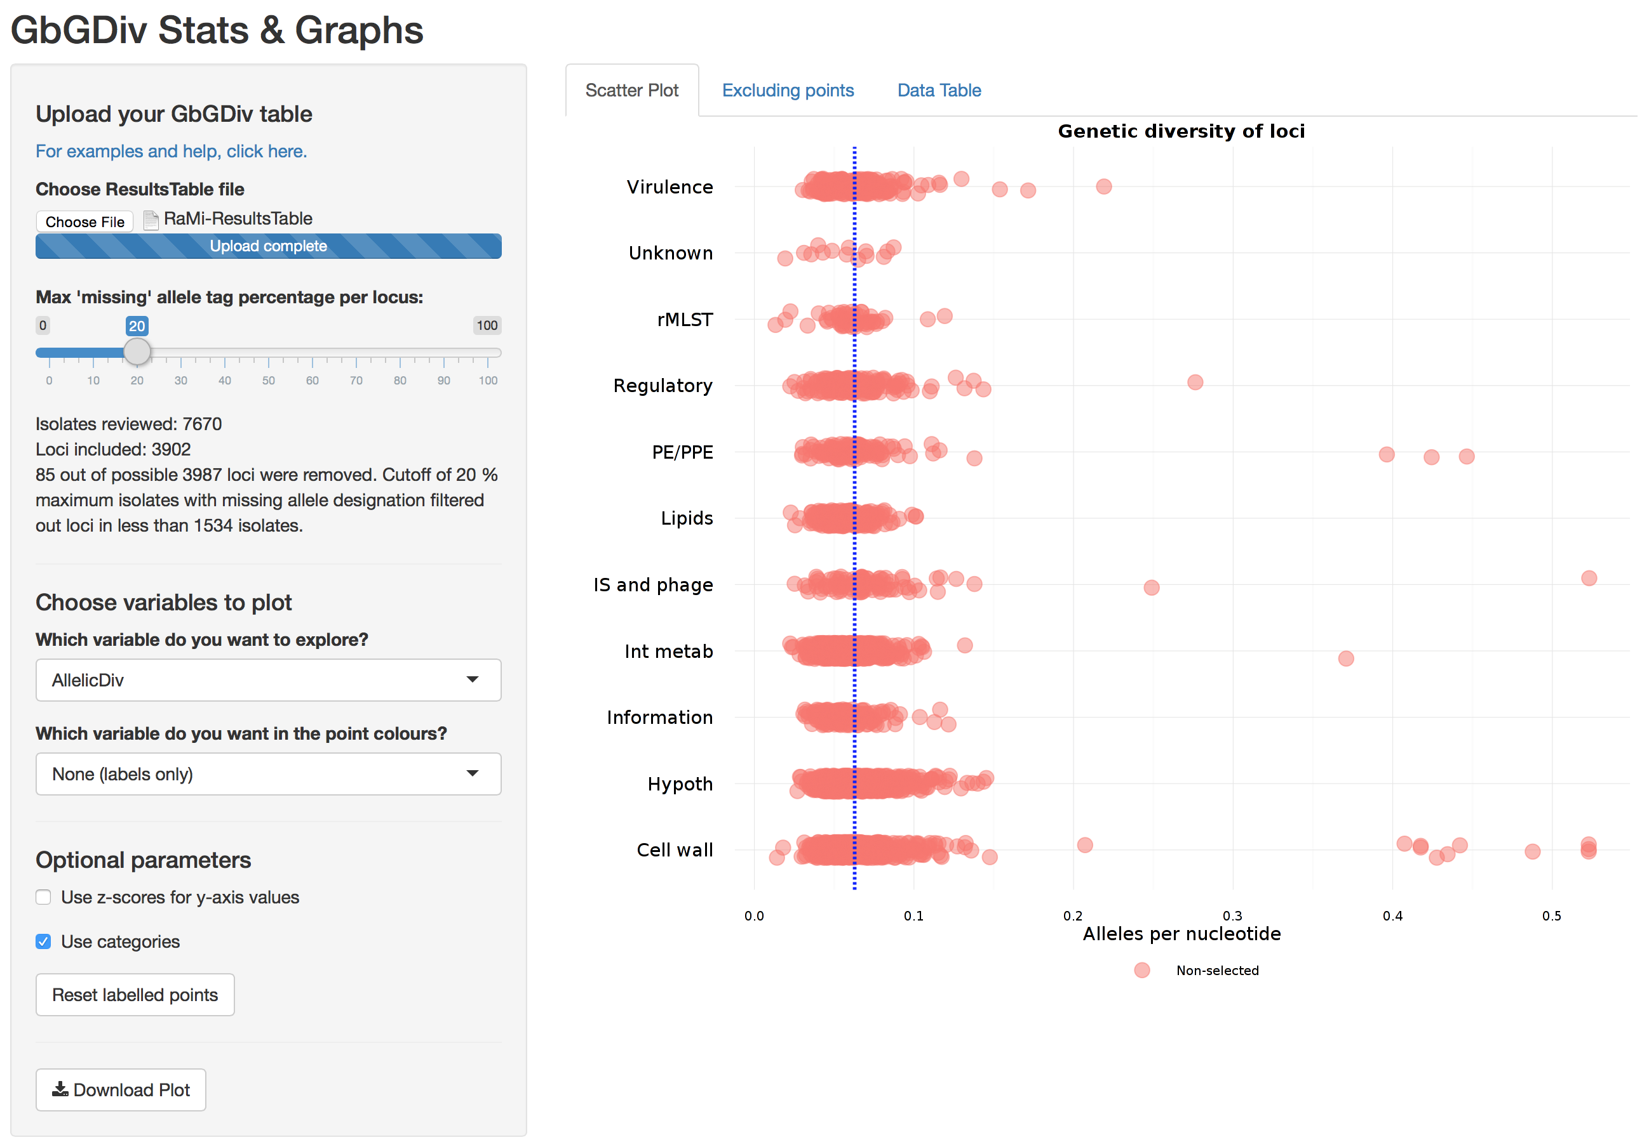

Slide 15
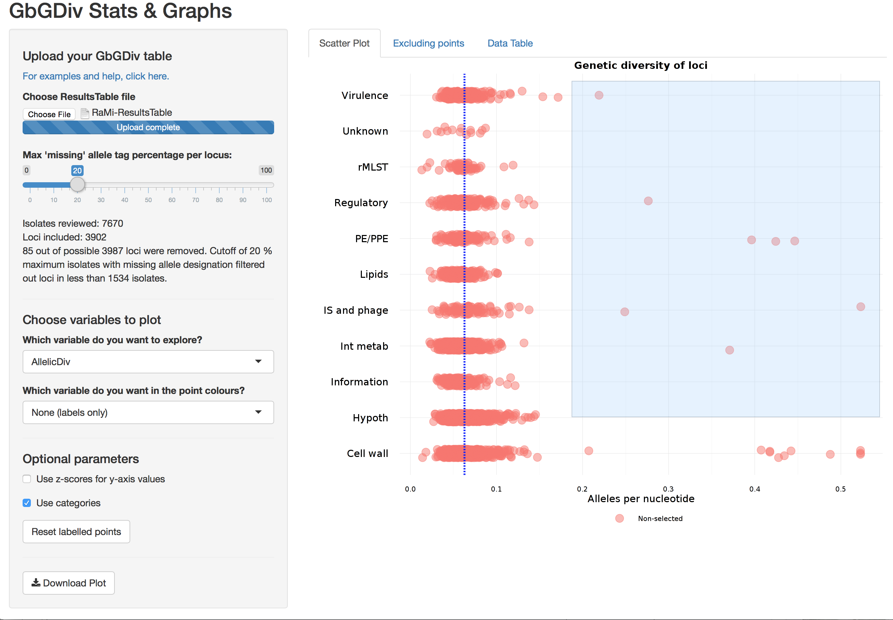

Slide 16
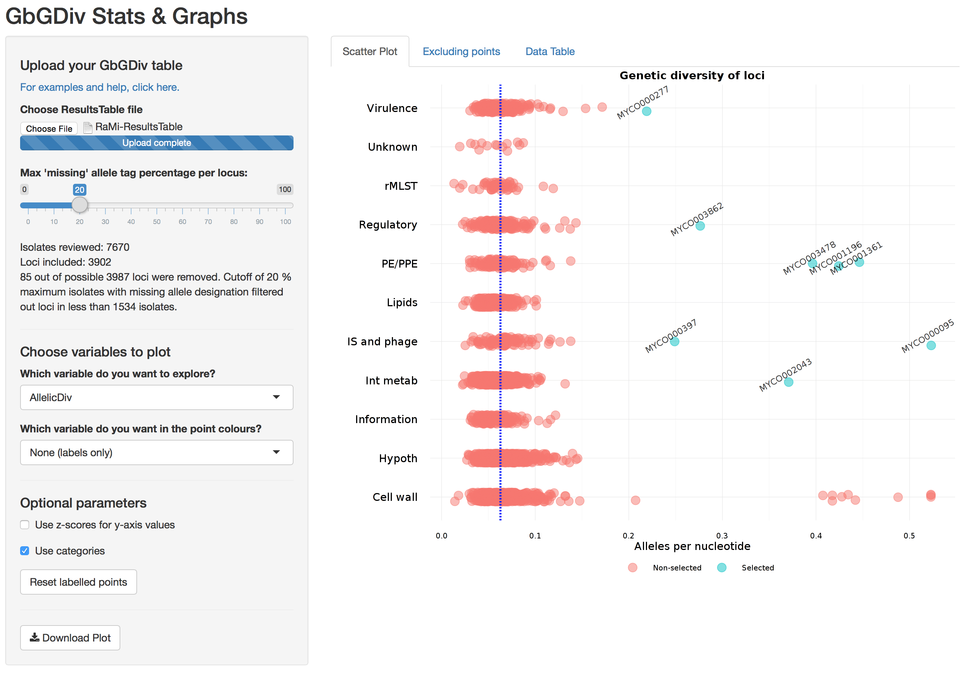

Slide 17
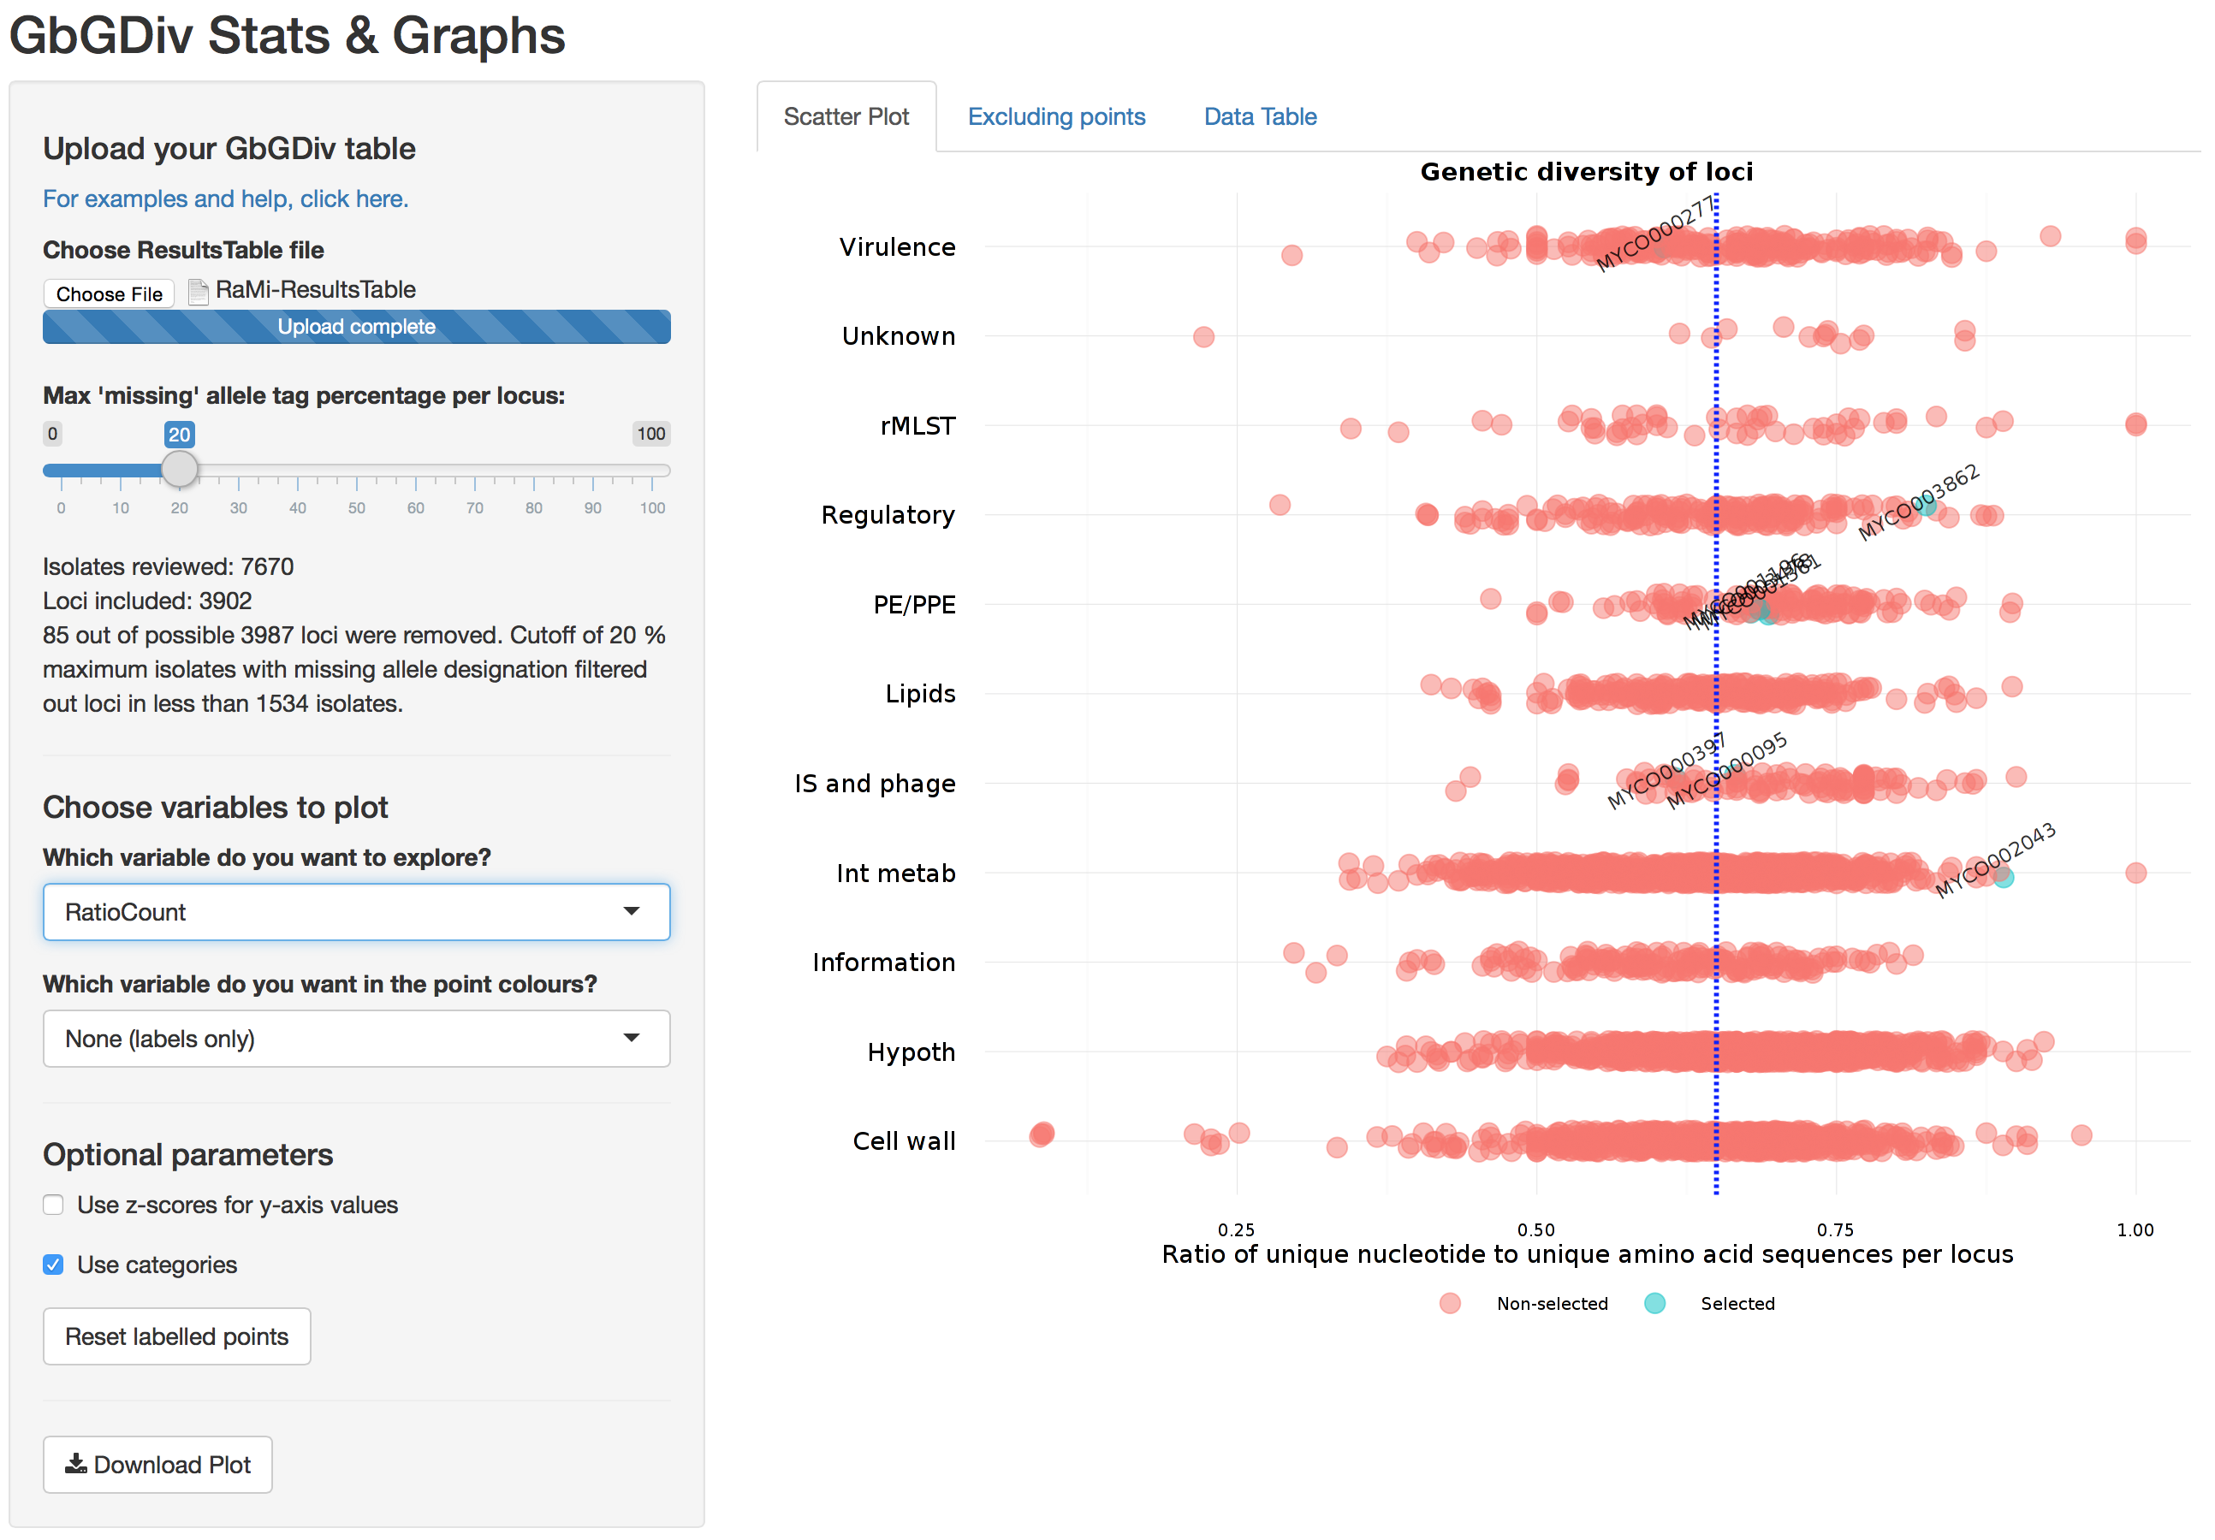

Slide 18
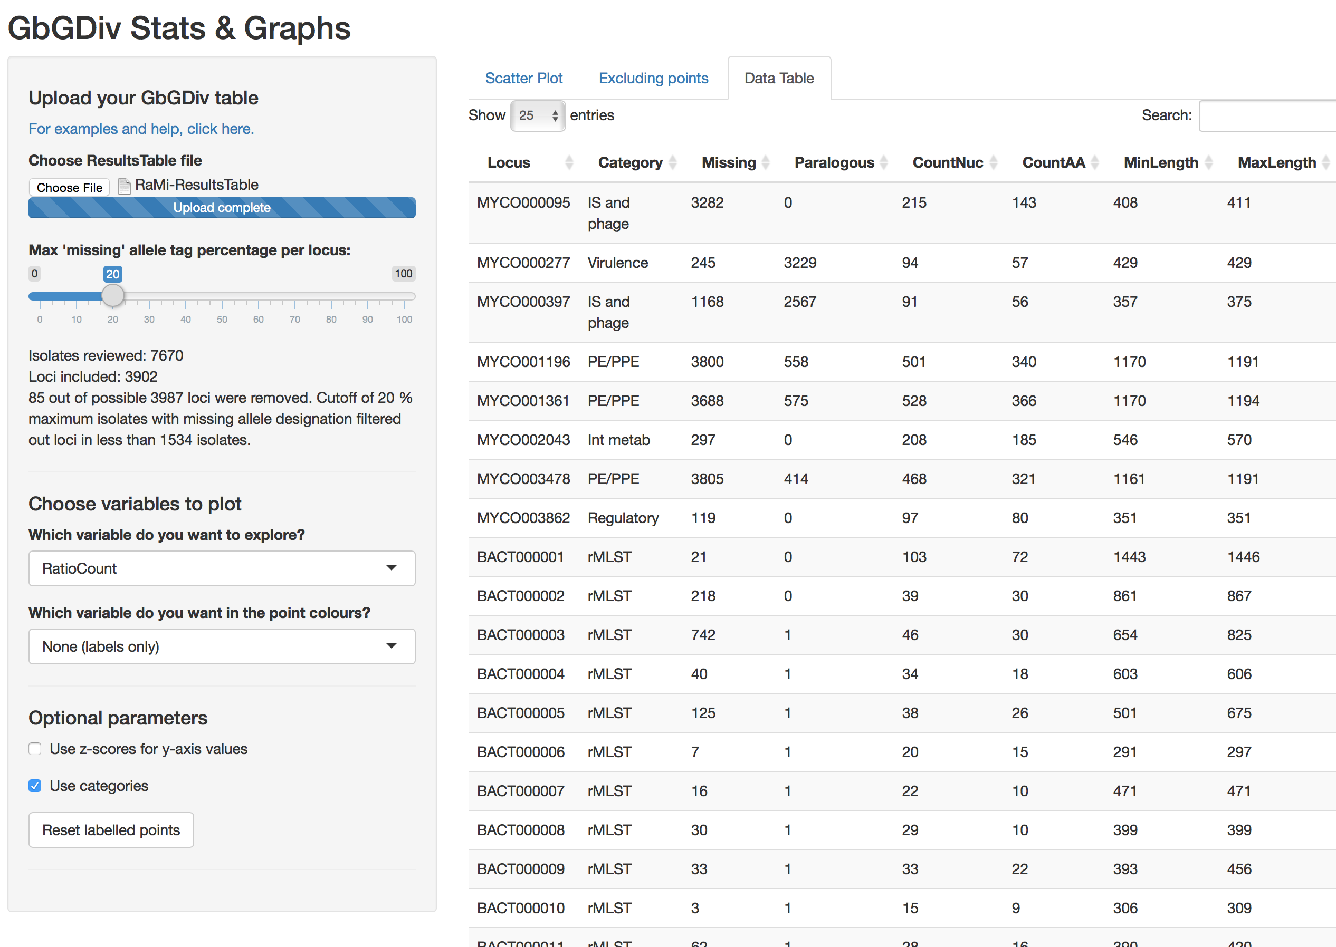

Slide 19
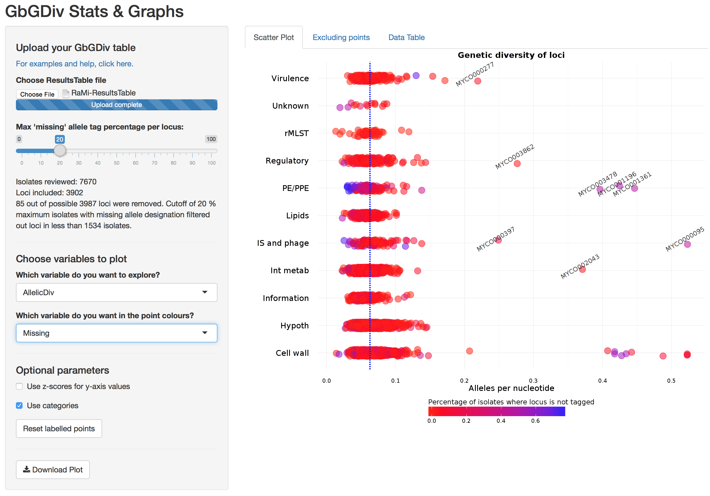

Slide 20
BIGS DB two-database system
Genomes database
Loci database
Isolate #141:
(N/A, F11, South Africa, epidemic…)
Isolate #142:
(1934, H37Rv, China, lab strain…)
Locus #12:
Locus #13:
Locus #14:
Locus #15:

Slide 21
BIGS DB two-database system
Genomes database
Loci database
Isolate #141:
(N/A, F11, South Africa, epidemic…)
Isolate #142:
(1934, H37Rv, China, lab strain…)
Locus #12:
Locus #13:
Locus #14:
Locus #15:
scanning & tagging
partial match

Slide 22
BIGS DB two-database system
Genomes database
Loci database
Isolate #141:
(N/A, F11, South Africa, epidemic…)
Isolate #142:
(1934, H37Rv, China, lab strain…)
Locus #12:
Locus #13:
Locus #14:
Locus #15:
new allele is defined

